Slide 1

The Readmission Program
Data Analysis Project

Slide 2
Hospital Reduction Readmission Program
Hospital Readmission Reduction Program (HRRP)
Introduced in 2010 by CMS established in Affordable Care Act
Authorize Medicare to reduce payment to the hospital with excess readmission rate
To reduce unplanned/unnecessary hospital readmission within 30 days of discharge
Improves Americans' health care by linking payment to the quality of hospital care
Penalize the hospital based on readmission rate
Reflect the breadth and depth of a care patient receives
Represents an opportunity to lower health care costs, improve quality, and increase patient satisfaction at once
Excess Readmission ratio measures hospital relative performance
Performs better than an average hospital that admitted similar patients(ERR<1) and vice versa.

Slide 3
Sentara RHM Medical Centre
Began as Rockingham Memorial Hospital (1912)
Serve seven-county area resident of nearly 218,000
Partnered with Sentara Healthcare System in May 2011
125 year old non-profit system 100 plus sites throughout VA and NC
Includes 12 acute care hospitals
National leader in heart and kidney also stroke and infection prevention
First in nation to develop eICU
Mission – Improve health everyday
Value- People, Quality, Safety and Integrity
Vision- To be the healthcare choice of the communities we serve

Slide 4

Analysis Goals
To discover the performance of selected hospital and comparing with other hospitals in the region and the country.
To find out the useful information and drawing the conclusion to eventually reducing the hospital Excess Readmission Ratio.
To determine plans and interventions that helps in reducing hospital readmission rates.

Slide 5
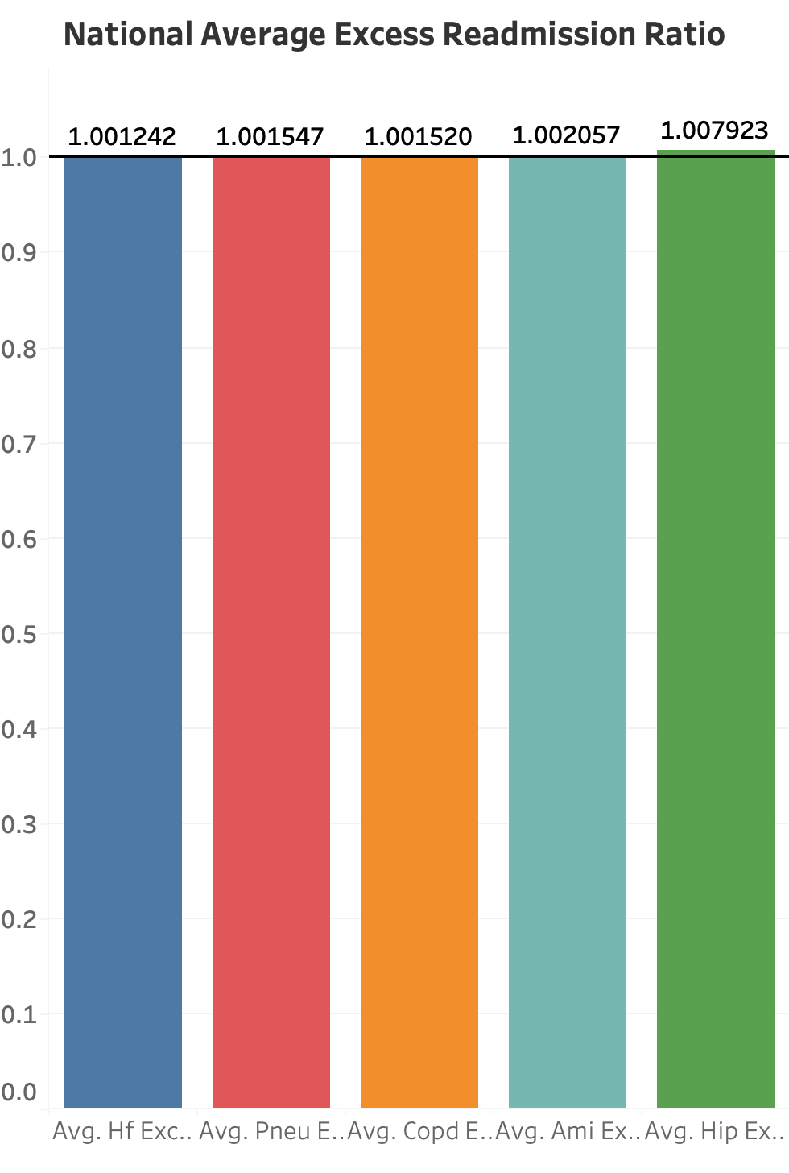
ERR at national level for all medical condition is above 1 resulting need for improvement.

Slide 6
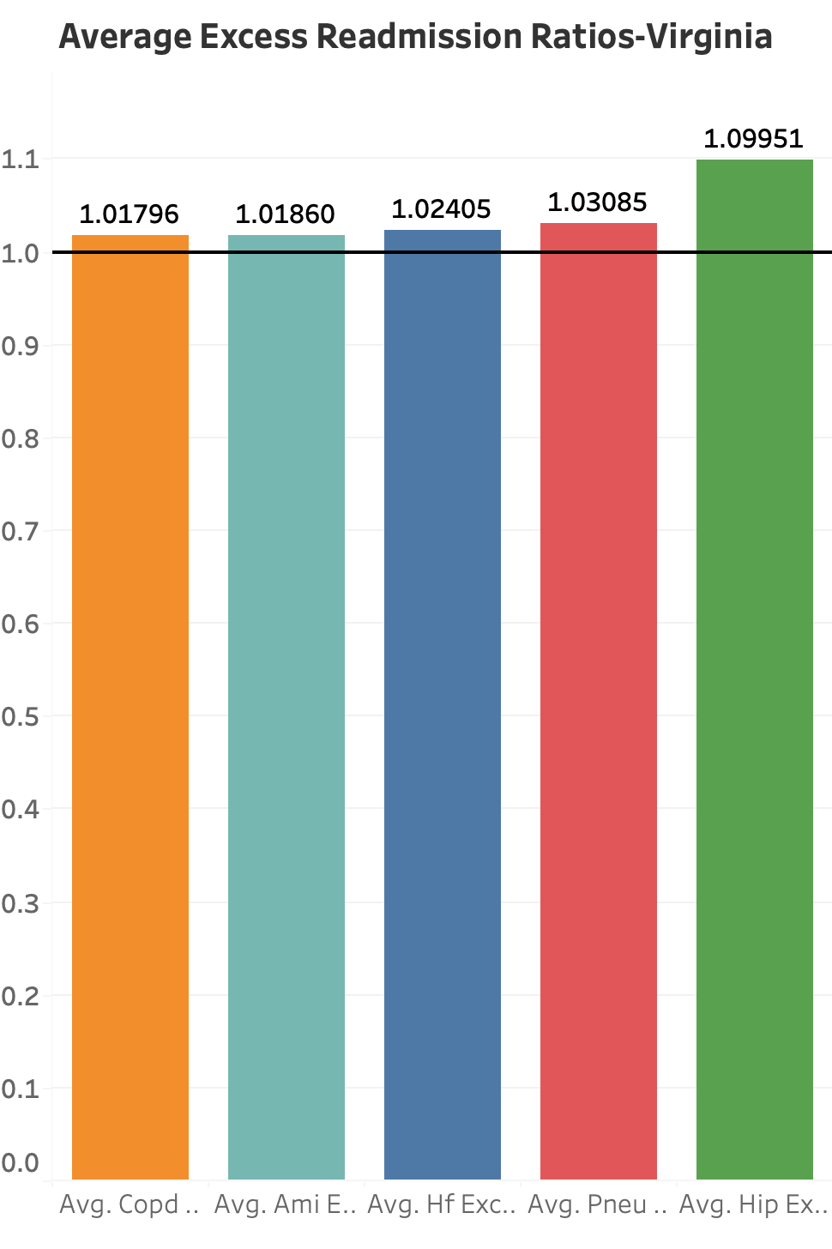
ERR for the sate of Virginia is more compared to the national level especially Hip Knee and Pneumonia related hospital readmissions.

Slide 7
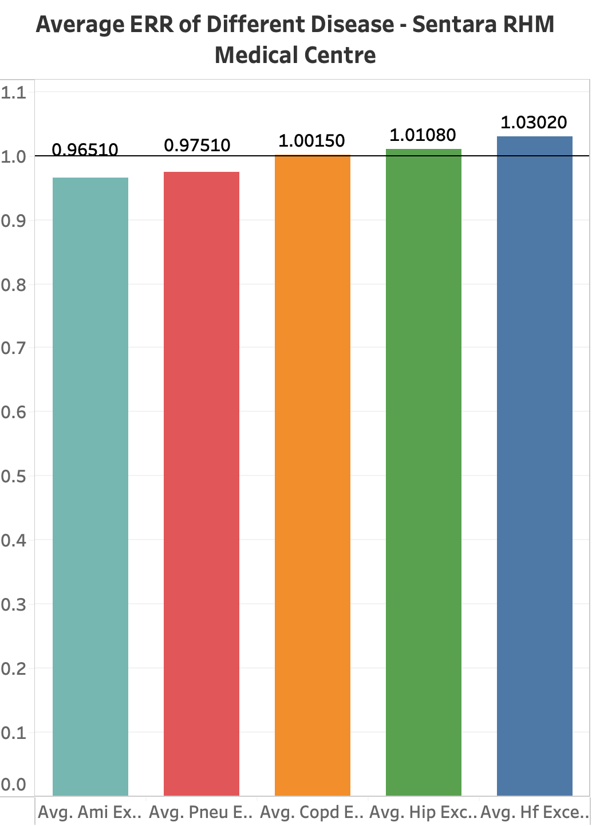
At Sentara RHM Medical Centre, the ERR for AMI,COPD, Pneumonia and Hip Knee are doing good except Heart Failure compared to the state and national average.

Slide 8

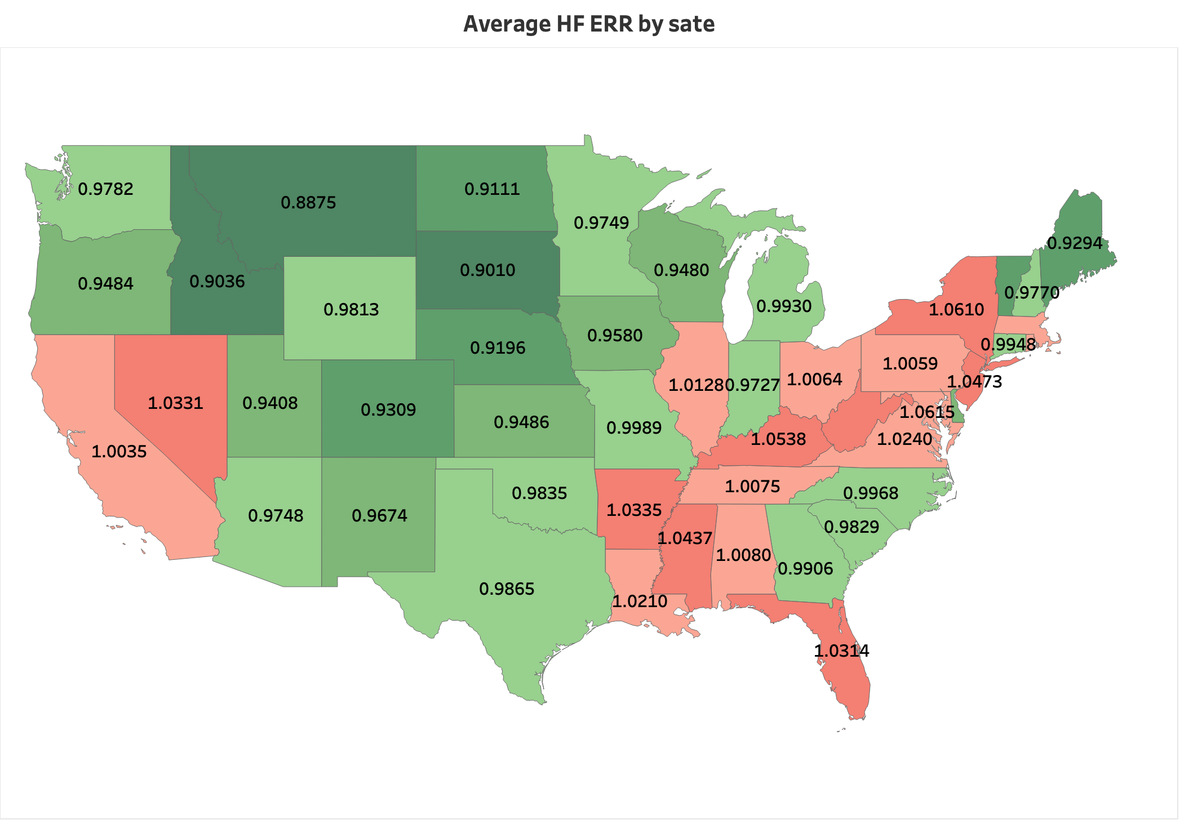
Northeast US (ME,VT,NH) and Southeast(except GA,SC,NC) has higher HF ERR compared to the Southwest and Midwest US.

Slide 9
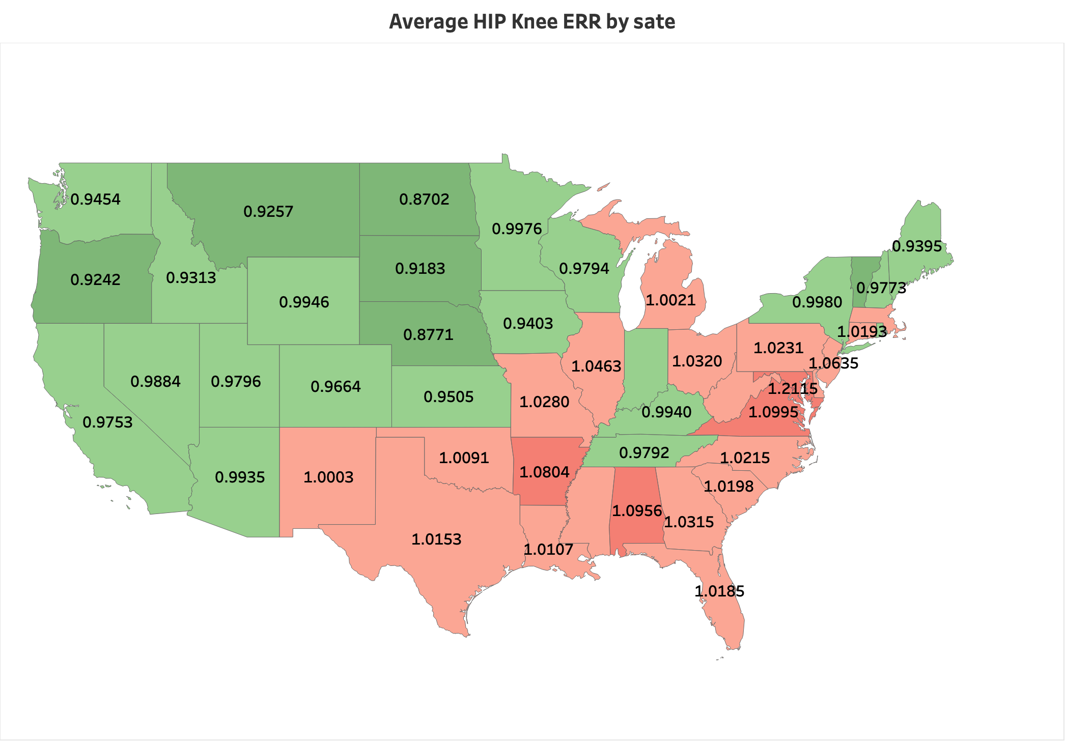
West coast and Northwest Pacific region are doing better in HIP Knee ERR in comparison to the rest US

Slide 10
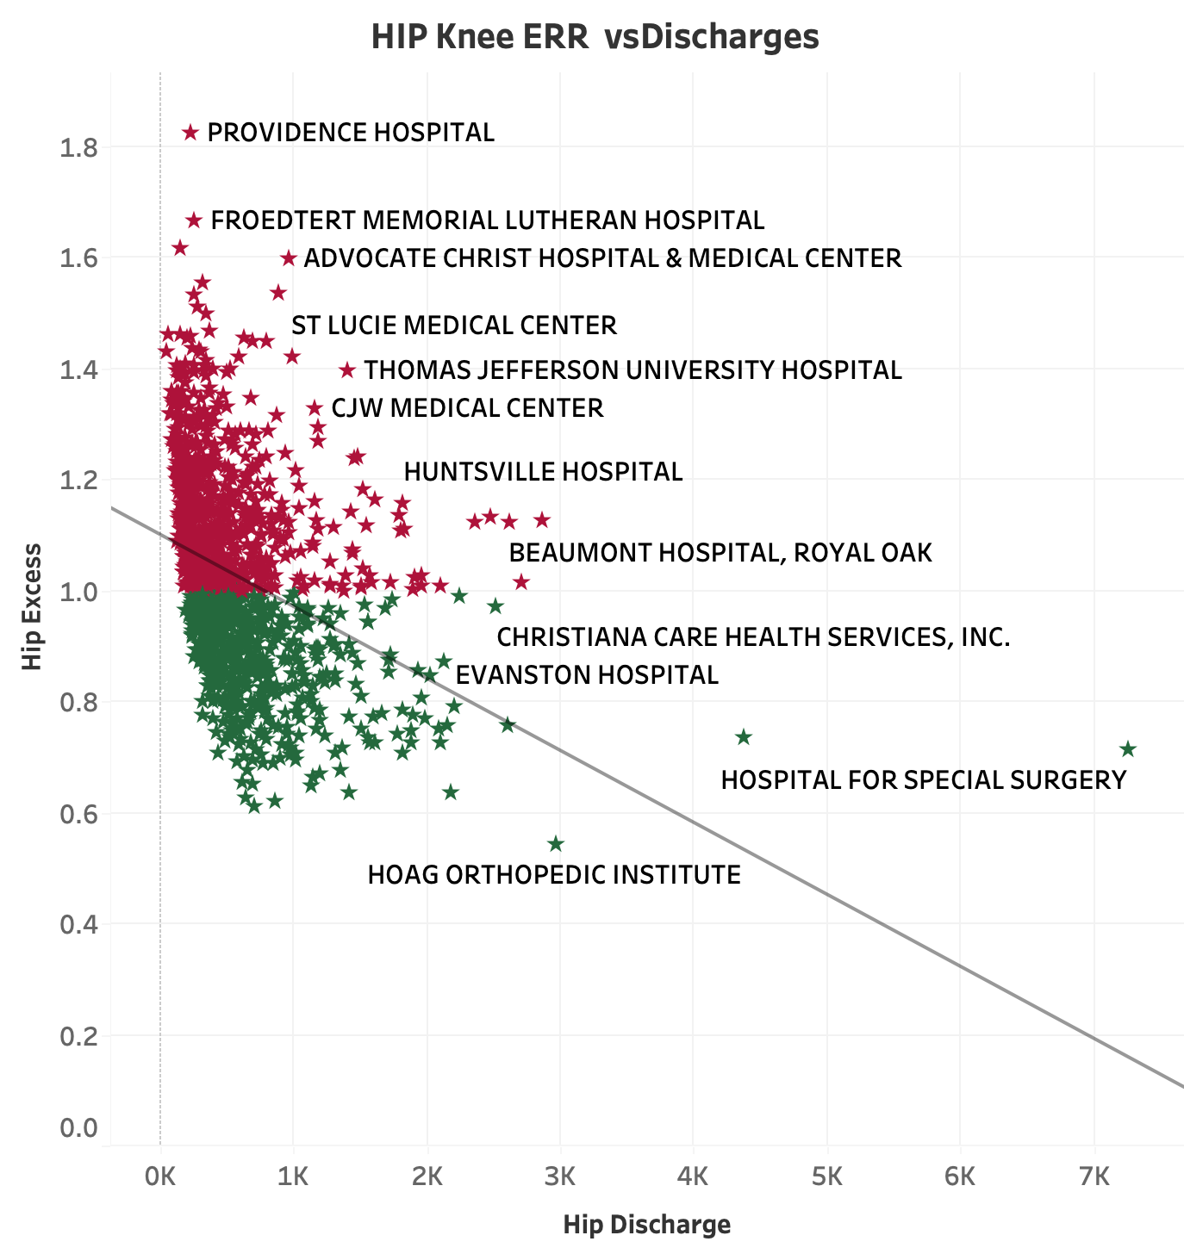
Hospitals Having a greater number of timely discharges of Hip Knee have less ERR .
Negative Relationship

Slide 11
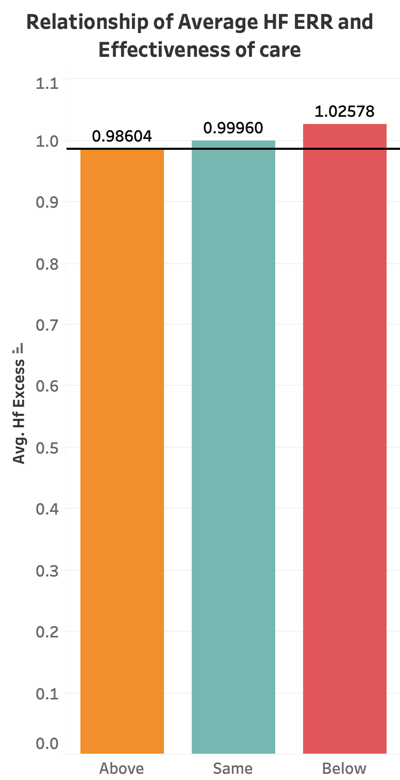
Hospitals having effectiveness of care below the national average have higher HF ERR.
Poor effectiveness of care leads to poor quality of care provided and poor management resulting in higher hospital readmission.

Slide 12
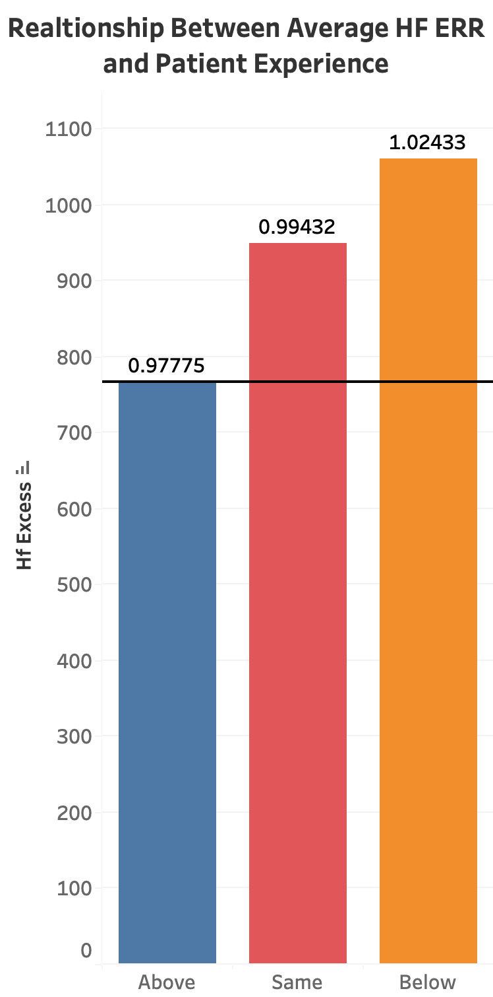
Hospitals with patient experience below the national average have higher HF ERR.
Patients who are satisfied and have a better communication with their care team are less likely to return for readmission .As a result hospitals having patient experience above the national average have less HF ERR.

Slide 13
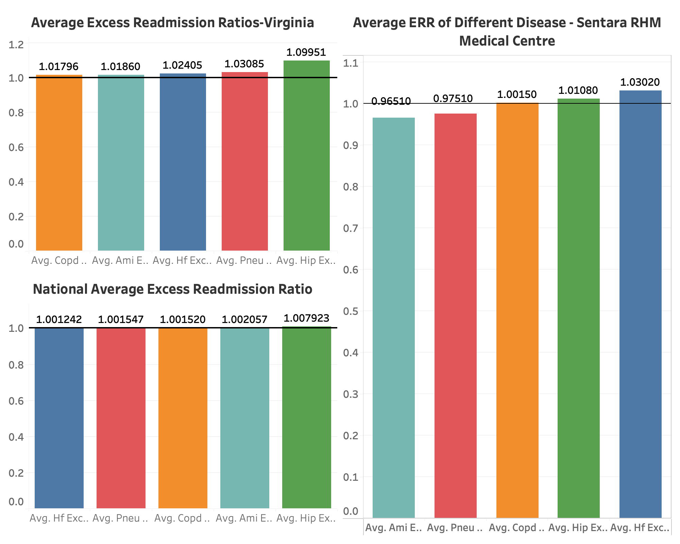
ERR For Sentara RHM Medical Centre and State and National Average
Sentara RHM- Average ERR is better when it comes to AMI, Pneumonia related hospital readmission compared to the National and the state level.
Lots of hard work is required to improve the Average ERR for COPD, Hip Knee and HF in this category.

Slide 14
Findings
ERR for the sate of Virginia is more compared to the national level especially Hip Knee and Pneumonia related hospital readmissions..
At Sentara RHM Medical Centre, the ERR for AMI,COPD, Pneumonia and Hip Knee are doing good except Heart Failure compared to the state and national average.
Northeast US (ME,VT,NH) and Southeast(except GA,SC,NC) has higher HF ERR compared to the Southwest and Midwest US.
Hospitals with patient experience below the national average have higher HF ERR.
Hospitals having a greater number of timely discharges of Hip Knee have less ERR .
Hospitals having effectiveness of care below the national average have higher HF ERR.
ERR at national level for all medical condition is above 1 resulting need for improvement.

Slide 15
Recommendation
Coach patients on discharge instructions and self management that focus on patient education, translation for non-English speaker and creating the checklist to ensure patient understand post-care instruction and changes in medication.
Ensuring patients schedule a seven-day follow-up. Patients who follow up with their physician within seven days of discharge are less likely to be readmitted to the hospital.
Identify patients at high risk for readmission
Utilize medication reconciliation
Optimize utilization of technology
Too early of hospital discharge.
Identifying best practices to reduce the rate; developing resources to improve care for heart failure patients and creating resources for patients to better manager their condition.
Implementing a robust home healthcare program. Post-discharge care can be a powerful mechanism for preventing readmissions.

